Slide 2
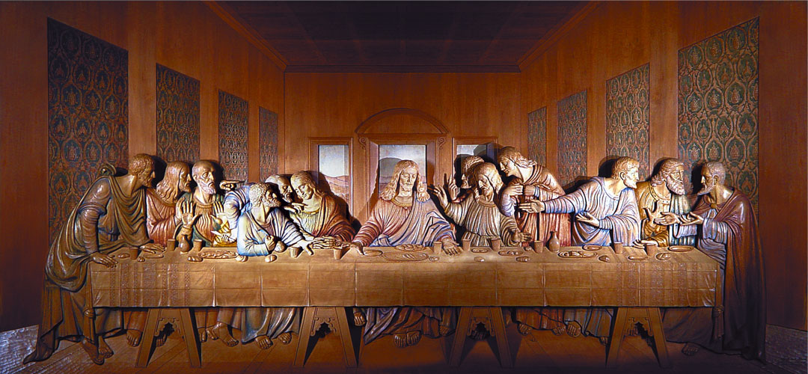
Matthew 26:26-28
The Lord’s Supper

Slide 3

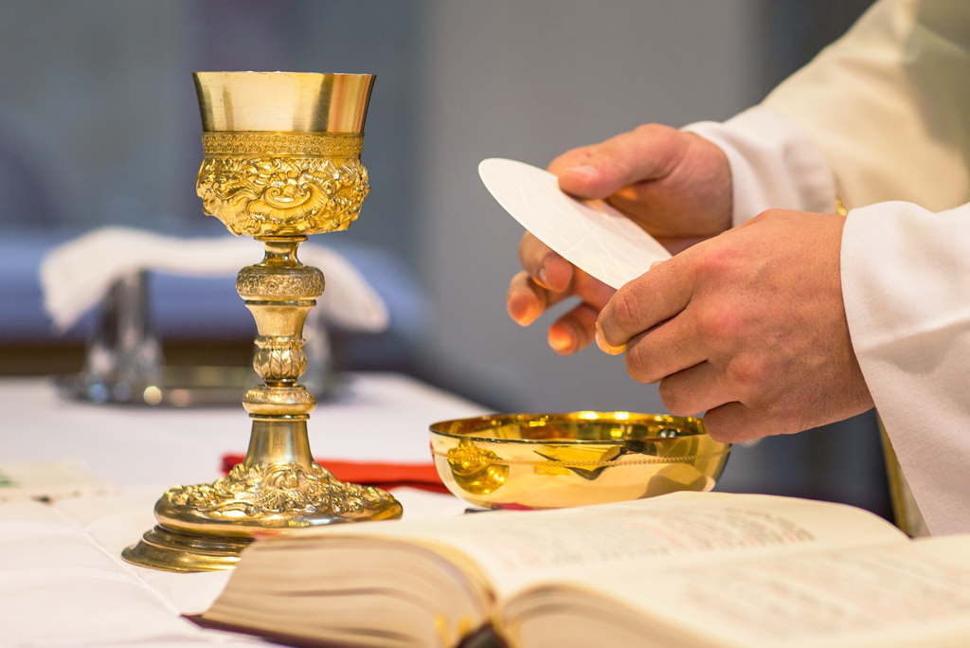
“The eucharist”
“Sacrament”

Slide 4
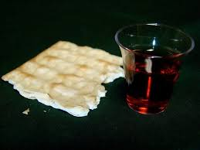
The Lord’s Supper
1 Corinthians 11:20
“A Communion of the body and blood of Christ” 1 Corinthians 10:16
“The Lord’s Table” – 1 Corinthians 10:21
“Breaking of Bread” Acts 2:42; 20:7

Slide 5
“to break bread”
Luke’s Language In Acts 20:11 Calls For Two Separate Meals
“Gathered together” for purpose of “breaking bread”
1 Corinthians 11:20,33
Why tarry in Troas for Seven Days?
NOT to eat a common meal
He desired to worship with them “on the first day of the week,” which included observing the Lord’s Supper with them
The Lord’s Supper (“had broken bread”)
Common Meal (“and eaten”)
Geusamenos - “is nowhere used of the celebration of the Supper, whereas in Acts 10:10 it is applied to taking a common meal”
“had broken the bread” – “seems plainly to denote the celebration of the Lord’s Supper; their intention to do so being expressed in Acts 20:7, but their actually doing it nowhere if not here”

Slide 6
Would this not be a Monday morning observance of the lord’s supper?
God did not specify which method of time to use, but did specify the numerical day of the week in which the Supper of the Lord is to be kept, Christians should abide by the standards of time wherever they reside
Jews began in the evening at sundown and lasted until sundown the following day
Paul’s pre-midnight preaching was on our Saturday evening, but it was the beginning of their “first day.”

Slide 7
What is the purpose of the lord’s supper?
TO BRING CHRIST TO OUR MEMORY
Not designed to satisfy physical hunger or thirst – 1 Corinthians 11:20-22
“his own supper” / “the Lord’s supper”
Eating and Drinking is to be done at home! V.22
Luke 22:19 “…do this in remembrance of Me.”
TO PROCLAIM HIS DEATH
1 Corinthians 11:26 “you proclaim the Lord’s death till He comes.”

Slide 8
The importance of this supper
1 Corinthians 11:20
“not possible to eat the Lord’s supper”
WHY?
They were not doing it TOGETHER!
A TOGETHER function of the local congregation
“wait for one another”
Continued Steadfastly- Acts 2:42 “continued steadfastly in the… breaking of bread,…”
1 Corinthians 11:33 “when you come together to eat”
To be done TOGETHER!

Slide 9
The institution of the lord’s supper
Matthew 26:17
Exodus 12:19,20
Christ Obeyed the Law of Moses, perfectly 1 Peter 2:22
Greek word for “fruit of the vine” not “wine”
ALL leaven was forbidden
Thus YEAST, FERMENT, whatever could excite fermentation
"leaven applied to the wine as really as to the bread." Gesenius, Hebrew scholar, 950 A.D.
At the “Last Supper,” of Jesus’ Last Observance of The Passover Feast
1 Corinthians 11:23-25
Paul received from the Lord & delivered to the saints!
Elements of the Lord’s Supper are:
Unleavened Bread and Fruit of The Vine

Slide 10
Who is to partake of the lord’s supper?
When is it to be observed?
Each First Day Of The Week
Acts 20:7 – 1st Day of week they met to “break bread”
No Particular First Day specified
Necessary Inference – their regular practice
1 Corinthians 16:2
Regular practice to meet, another obligation they were given on that day!
Jesus placed in His Kingdom, to be partaken of by Citizens of His Kingdom
Luke 22:29,30 “you may eat and drink at My table in My kingdom”
Observed by Christians in the First Century

Slide 11
How is the lord’s supper to be observed?
Inward – Each Person to Examine Himself, and Partake in the Correct Manner, Properly understanding the significance of the Break and Fruit of the Vine
1 Corinthians 11:28
Outward – “Proclaiming the Lord’s Death”
1 Corinthians 11:26
Forward – “till He comes”
Upward – Hebrews 11:6 “he who comes to God must believe that He is”
Heart of the Christian to look Five Ways:
Backward – To the Death of Christ on the Cross – 1 Corinthians 11:29
Discern: "not distinguishing the body of the Lord" from common food).”
Bread for His body – Fruit of the Vine for His Blood

Slide 12
Never intended to forgive sins
Where did they get such an idea?
Catholics believe it!
It is a Memorial – and does not facilitate the forgiveness of SINS!
We DO SIN whenever we willfully fail to observe it, or fail to observe it properly!
1 Corinthians 11:27,29

